Slide 1
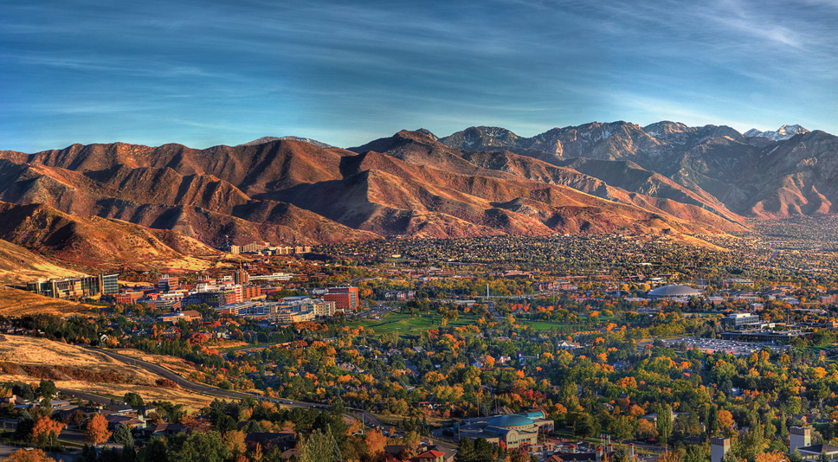
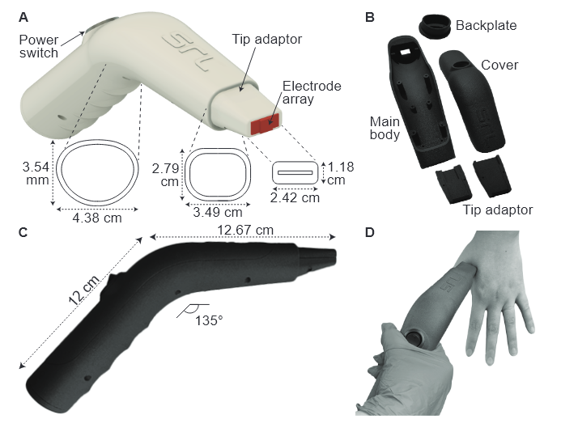

MILESTONE 2 UPDATE:
Integrating Machine Learning Into
UTAP App
<N
Hayden Walpole and Daniel McNally
Technical Advisor: Nathan Hansen & Prof. Benjamin Sanchez

Slide 2
MILESTONE 1 UPDATE:
Integrating Machine Learning Into URSKIN App
<N
Hayden Walpole and Daniel McNally
Technical Advisor: Nathan Hansen & Prof. Benjamin Sanchez

Slide 3

Our Timeline
Milestone | Estimated Completion
Working Frontend UI | March 15th, 2025
Single Model ML Prototype | April 15th, 2025
Multiple Model ML Application | November 1st, 2025
Final Integrated Application | November 30th, 2025
Demo Day | December 5th, 2025

Slide 4
Team Contributions
Daniel
Hayden
User Interface
ONNX Model Manager
Voting Algorithm
Extracting Model Confidence and Prediction
ADABoosting Model Testing:
-Default Data Arrays
-Measure Data from Device
FUTURE:
UI Finalization
Possible Changes to Voting Algorithm
Electrode Array Improvement?
FUTURE:
Results validation and comparison to PC model
Possible Changes to Voting Algorithm

Slide 5
Original User Interface
User interface changes

Slide 6
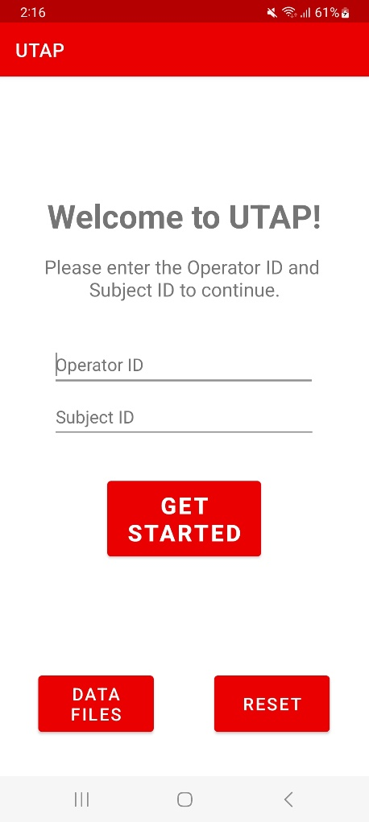
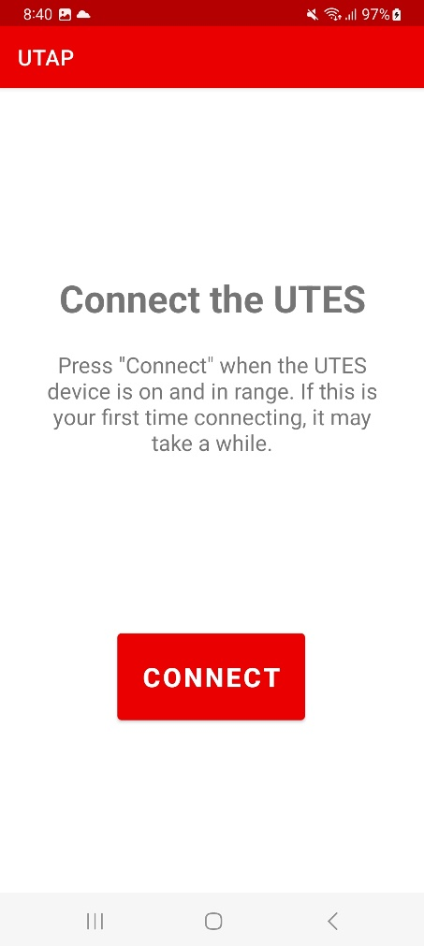
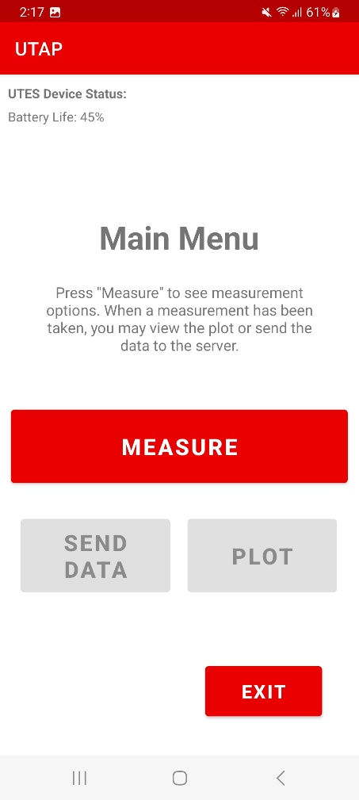
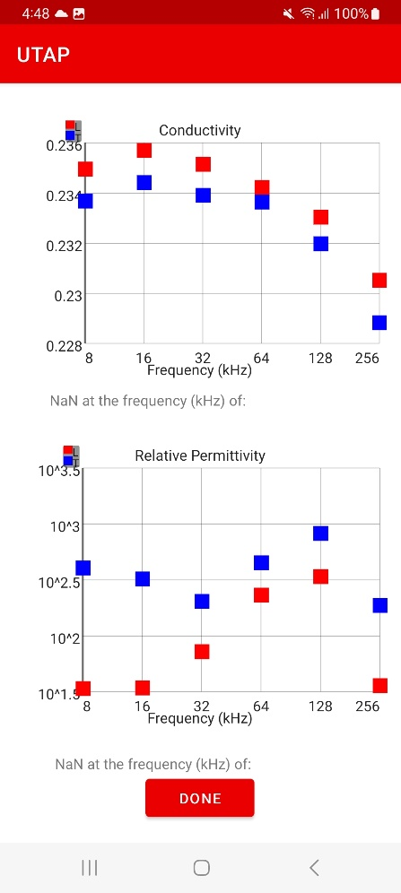
Original User Interface

Slide 7
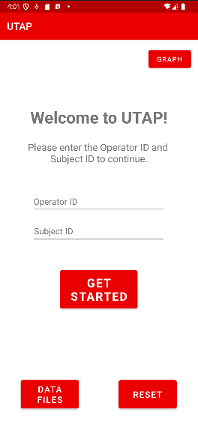
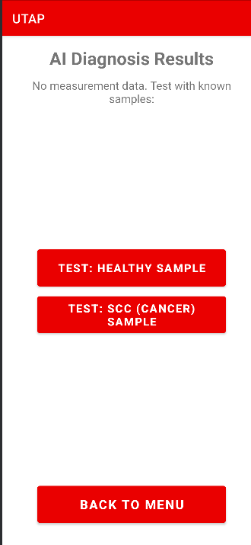
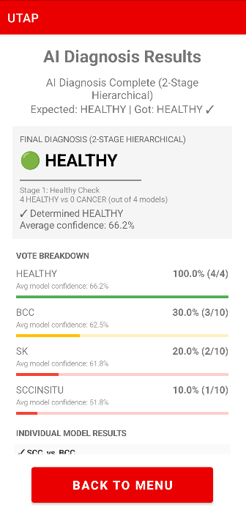
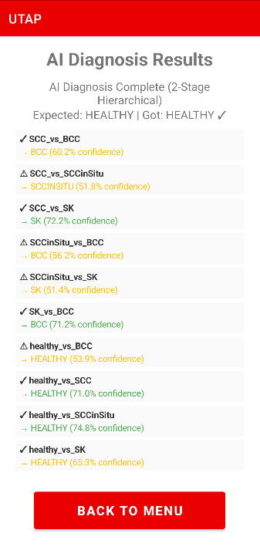
New User Interface

Slide 8
Original User Interface
Multiple Model and
Voting Implementations

Slide 9
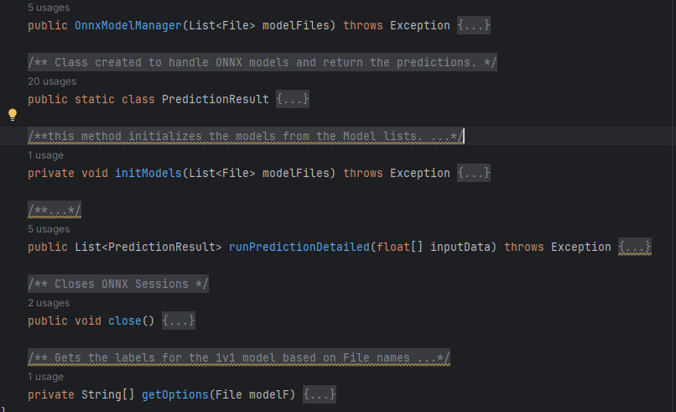
ONNX Model Manager

Slide 10
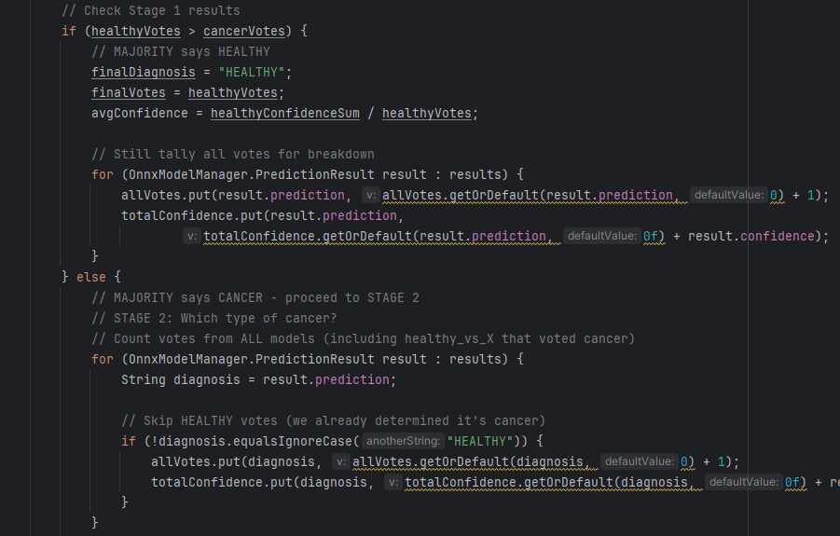
Voting

Slide 11
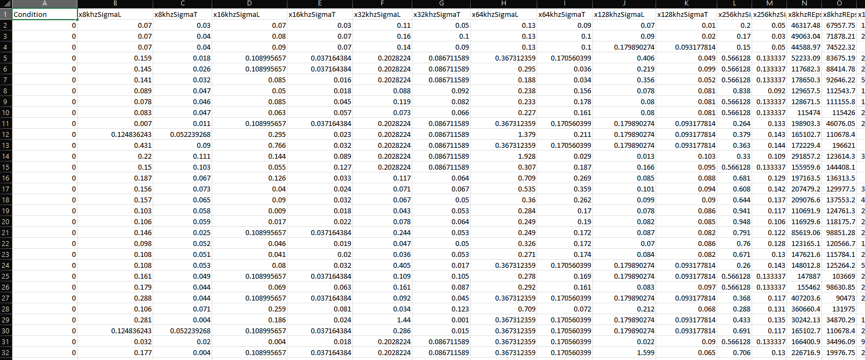
Data File SCC_vs_Healthy

Slide 12
Thank You!
DEMO

Slide 13
Plans going Forward
Finalize User interface and integrate more models.
Create an array of more extensive tests to ensure correct predictions from Testing data
Finish Documentation and Model Voting

Slide 14
Thank You!
Questions?

Slide 15
Image Sources:
Images from ONNX mainpage found at https://onnx.ai/
Images from “UTES Training Guide V6” PowerPoint created by Nathan Hansen
Images from materials from the Sanchez Research Lab UTES Device Resources and Publications

